Slide 1
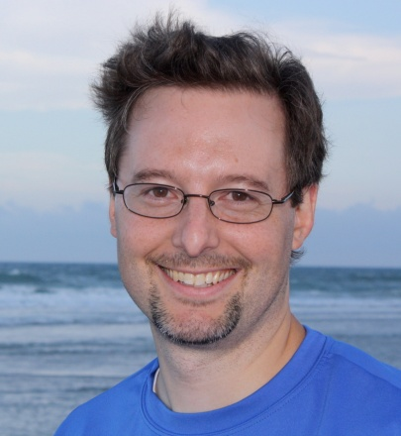
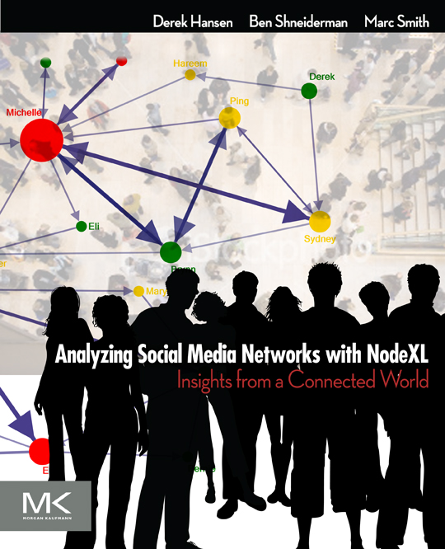


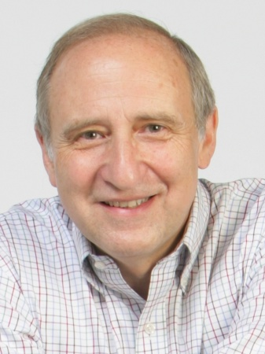
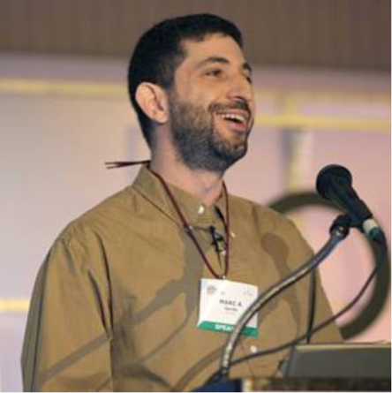
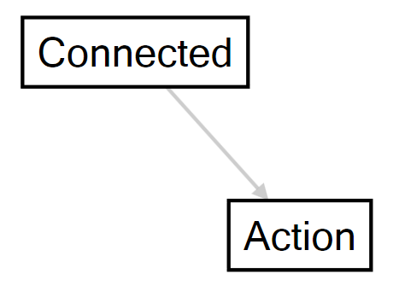
Forthcoming, Summer 2010

Slide 2
Derek L. Hansen is an assistant professor at Maryland’s iSchool and director for the Center for the Advanced Study of Communities and Information (http://casci.umd.edu), a multidisciplinary research center focused on harnessing the power of novel social technologies to support the needs of real and virtual communities. He is also an active member of the Human Computer Interaction Lab (www.cs.umd.edu/hcil). Dr. Hansen completed his Ph.D. from the University of Michigan’s School of Information where he was an National Science Foundation–funded interdisciplinary STIET Fellow (http://stiet.si.umich.edu) focused on understanding and designing effective online sociotechnical systems. His research and teaching focus on mass collaboration, information reuse, consumer health informatics, and social network analysis of online communities.
Ben Shneiderman (www.cs.umd.edu/~ben) is a professor in the Department of Computer Science and founding director (1983-2000) of the Human-Computer Interaction Laboratory (www.cs.umd.edu/hcil) at the University of Maryland. He was elected as a Fellow of the Association for Computing (ACM) in 1997 and a Fellow of the American Association for the Advancement of Science (AAAS) in 2001. He received the ACM SIGCHI Lifetime Achievement Award in 2001. Shneiderman is the co-author, with Catherine Plaisant, of Designing the User Interface: Strategies for Effective Human-Computer Interaction (5th ed., April 2009), www.awl.com/DTUI. With S. Card and J. Mackinlay, he co-authored “Readings in Information Visualization: Using Vision to Think” (1999). With Ben Bederson he co-authored The Craft of Information Visualization (2003). His book Leonardo’s Laptop: Human Values and the New Computing Technologies appeared in October 2002 (MIT Press) (http://mitpress.mit.edu/leonardoslaptop) and won the IEEE book award for Distinguished Literary Contribution.
Marc A. Smith is a sociologist specializing in the social organization of online communities and computer-mediated interaction. Smith leads the Connected Action consulting group and lives and works in Silicon Valley, California. Connected Action (www.connectedaction.net) applies social science methods in general and social network analysis techniques in particular to enterprise and Internet social media usage. He is the co-editor, with Peter Kollock, of Communities in Cyberspace (Routledge), a collection of essays exploring the ways identity, interaction, and social order develop in online groups. Smith received a B.S. in International Area Studies from Drexel University in Philadelphia in 1988, an M. Phil. in social theory from Cambridge University in 1990, and a Ph.D. in Sociology from UCLA in 2001. He is an affiliate faculty at the Department of Sociology at the University of Washington and the College of Information Studies at the University of Maryland. Smith is a Distinguished Visiting Scholar at the Stanford University Media-X program.

Slide 3
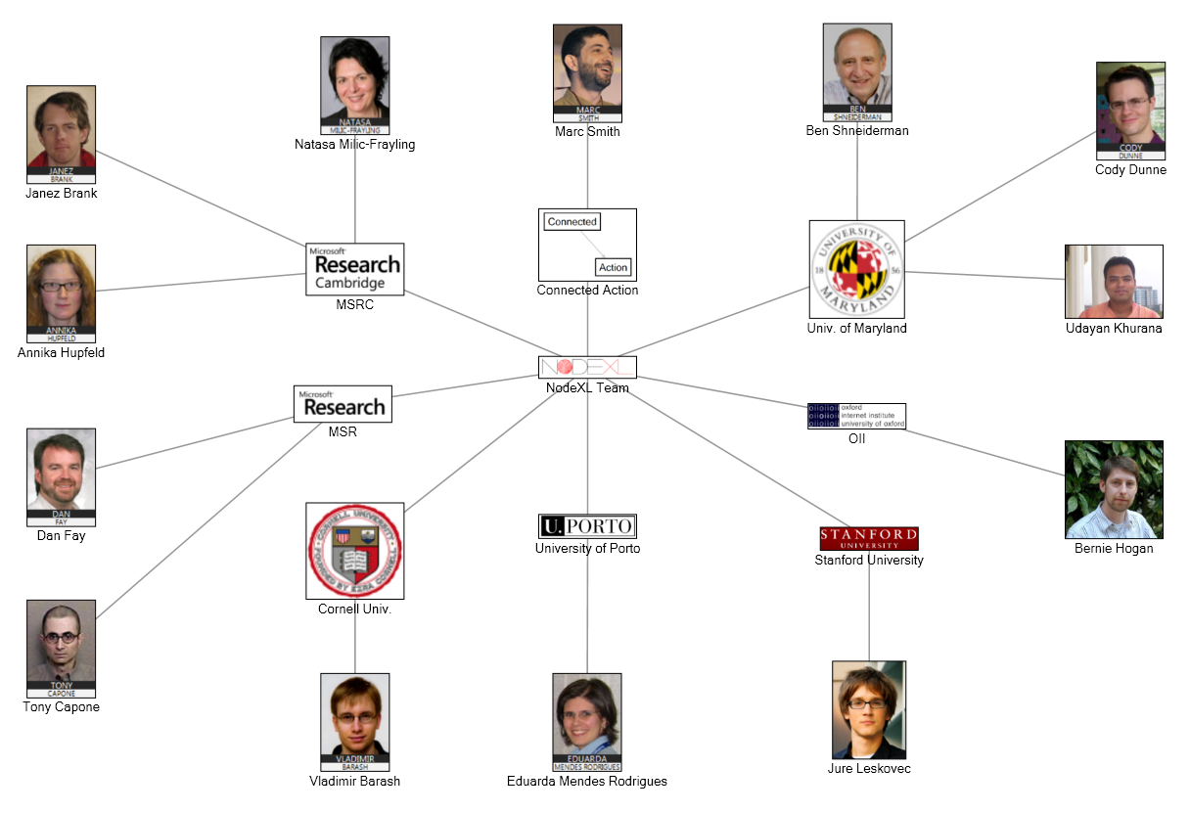

Slide 4
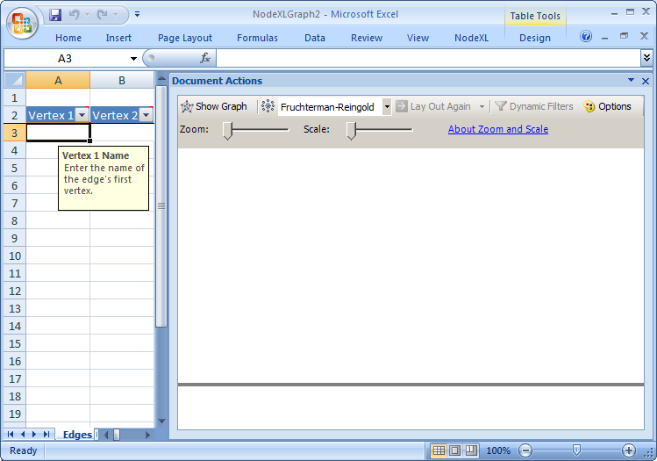
Figure 4.1: Starting with an empty NodeXL Edges worksheet (left) and graph pane (right)

Slide 5
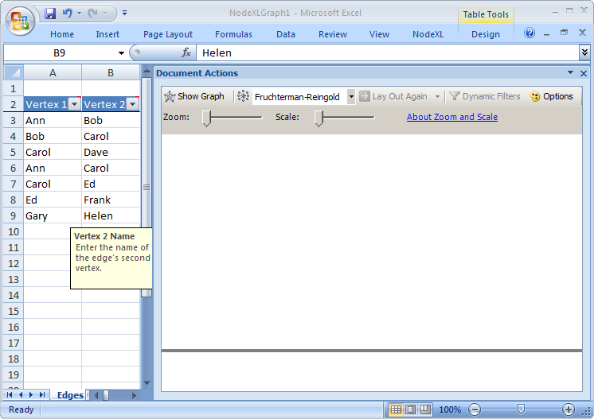
Figure 4.2: Seven friendships typed by hand into the Vertex 1 and Vertex 2 columns in NodeXL.
For example, Ann and Bob are friends

Slide 6
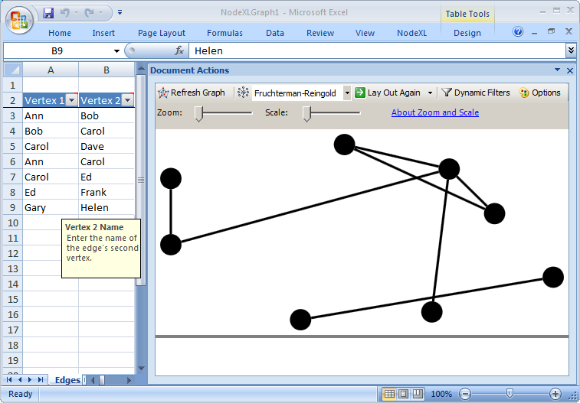
Figure 4.3: Your first NodeXL graph using the Fruchterman-Reingold layout shows the 8 friends and 7 friendships

Slide 7
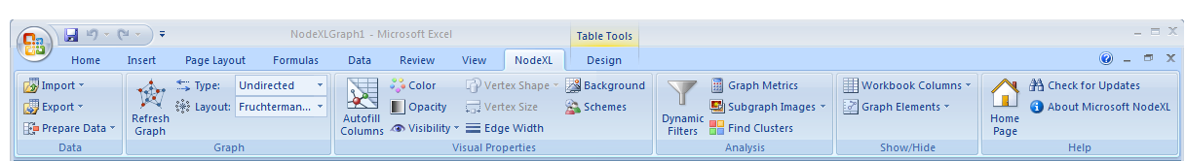
Figure 4.5 The NodeXL menu ribbon has sections for Data, Graph, Visual Properties, Analysis, Show/Hide, and Help

Slide 8
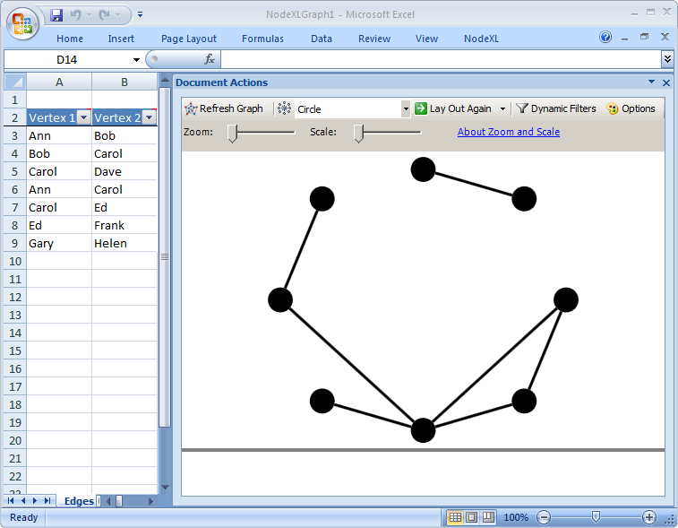
Figure 4.6: Vertices for 8 friends arranged automatically using the Circle layout in NodeXL

Slide 9
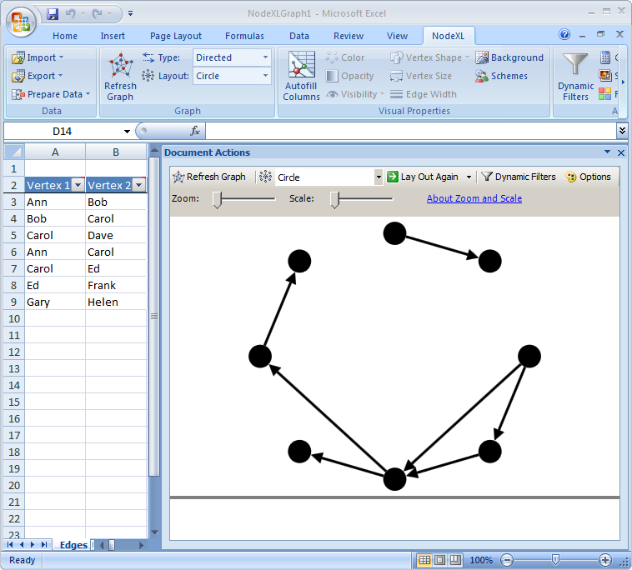

Slide 10
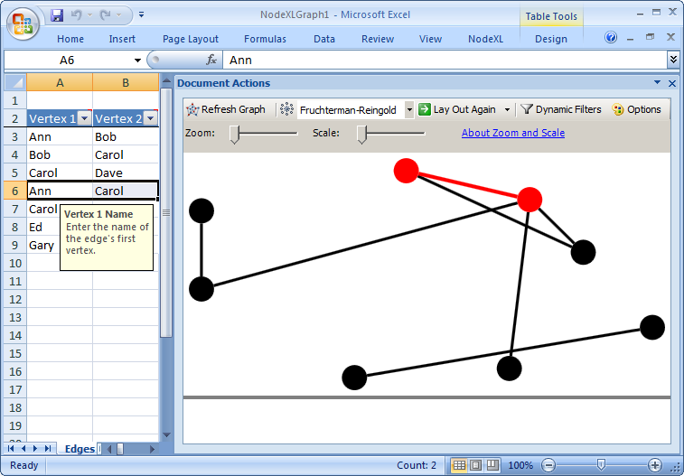
Figure 4.4: Clicking on row 5 in NodeXL (Ann and Carol) highlights their friendship edge in the graph pane

Slide 11
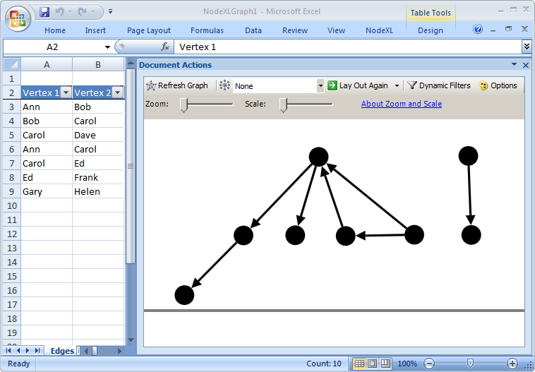
Figure 4.8: This manually arranged network graph in NodeXL shows two separated groups (often called components) and emphasizes the importance of Carol who has given and received two invitations.

Slide 12
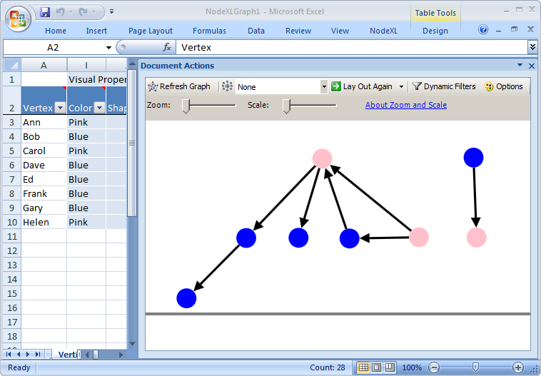
Figure 4.9: Color coding vertices in NodeXL helps quickly identify women (pink) and men (blue)

Slide 13
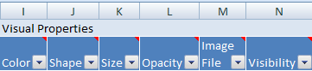
Figure 4.11: In NodeXL, vertices can have properties such as Color, Shape, Size, and Opacity

Slide 14
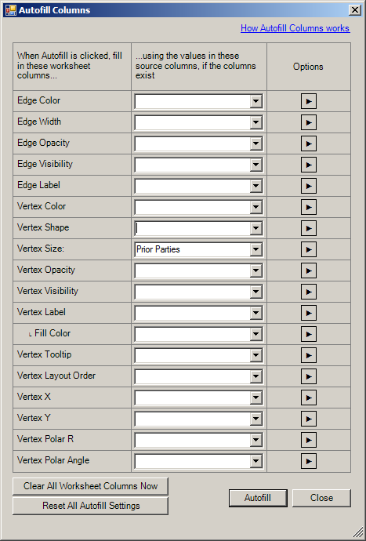
Figure 4.13: The Autofill Columns dialog used to set Vertex Size values based on the number of Prior Parties.
Selecting the Autofill button populates the Size column and refreshes the graph.

Slide 15
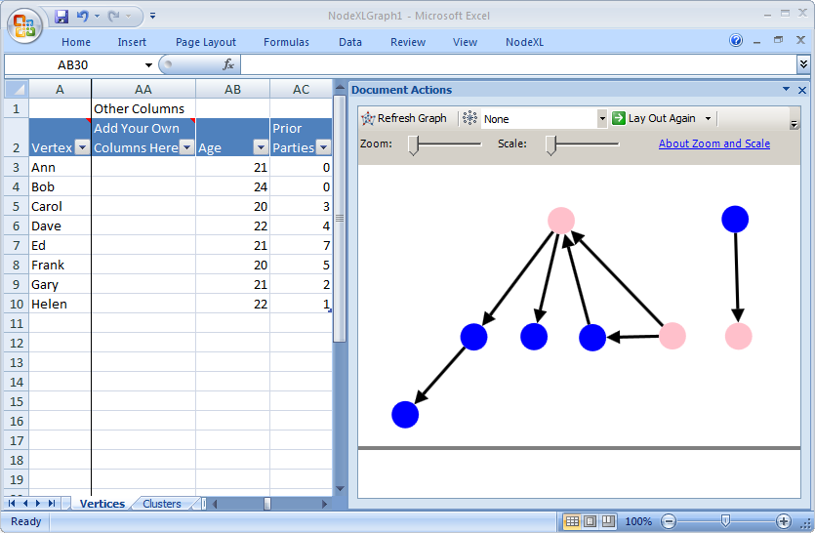
Figure 4.10: The NodeXL Vertices worksheet now includes user supplied columns for Age and number of Prior Parties

Slide 16
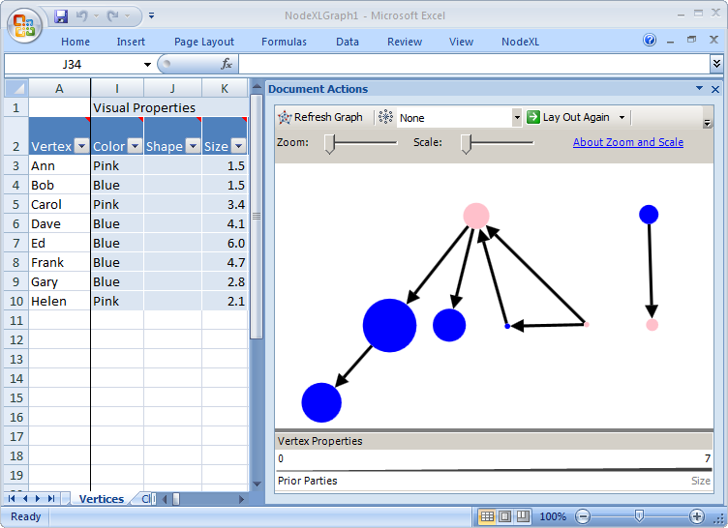
Figure 4.12: Vertex sizes have been populated using the NodeXL Autofill Columns feature based on the number of Prior Parties attended, revealing the wide disparity in social activity. The Legend at the bottom of the graph pane shows the range of values for Prior Parties (0 – 7) and their mapping to Size (line width of 1.5 – 6).

Slide 17
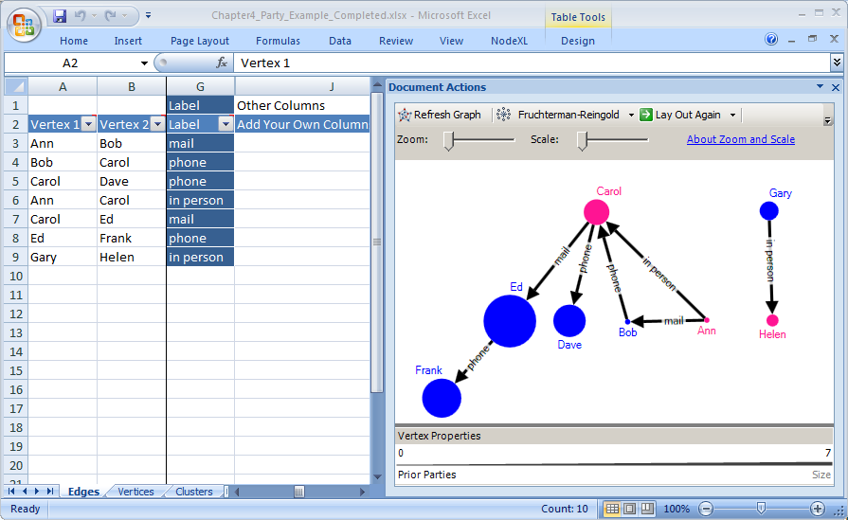

Slide 18
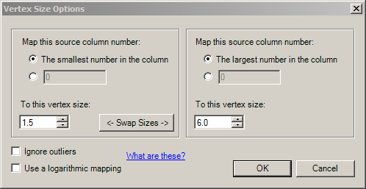
Figure 4.14: NodeXL Vertex Size Options dialog allows you to set the range for sizes. Setting the range to be from 1.5 to 6.0 ensures that all vertices are visible and avoids overlap of vertices.

Slide 19
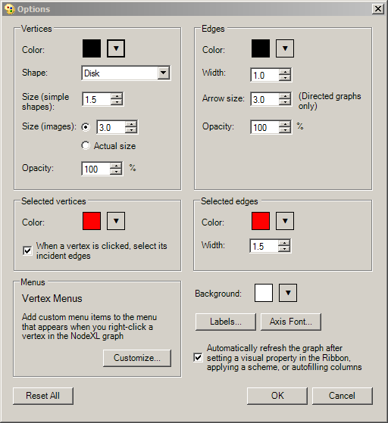
Figure 4.15: NodeXL Graph Options dialog box shows current values for the visual properties of vertices and edges

Slide 20
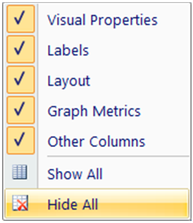
Figure 4.16: Groups of related NodeXL Workbook Columns can be shown or hidden by checking and unchecking the appropriate boxes.

Slide 21
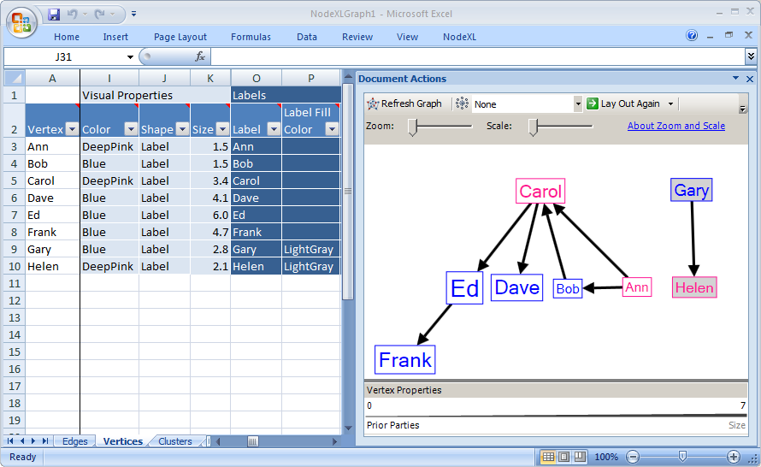
Figure 4.17: Labels are used as the Shape after using Autofill Columns to populate the Vertex names in NodeXL.
The Label Fill Color is manually set to LightGray to clearly show the separation of Gary and Helen from the rest of the group.

Slide 22
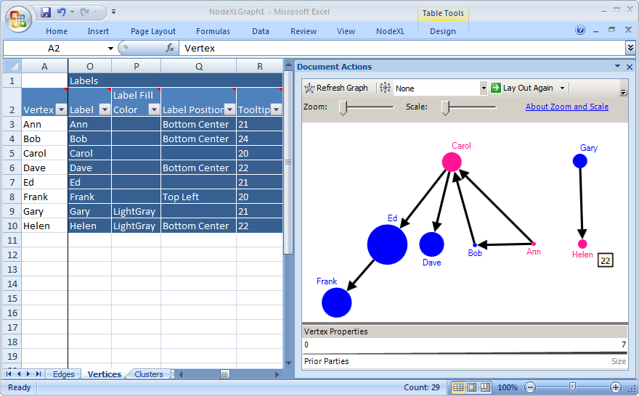
Figure 4.18: NodeXL can display Labels outside the vertices, making the size information more easily comparable. Labels are positioned so they don’t overlap with edges. Helen’s tooltip of 22 (her Age) is shown when hovered over.

Slide 23
Figure 4.19: Edge Labels, entered into the Label column on the Edges worksheet, indicate the medium through which a party invitation was extended (e.g., phone, mail, or in person).

Slide 24
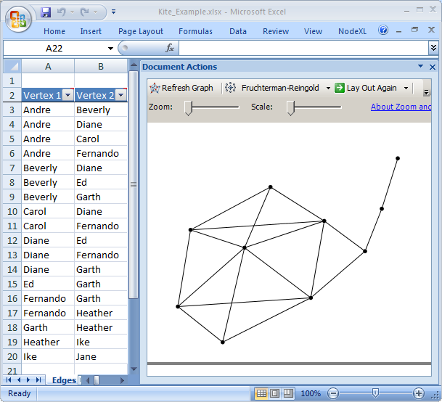
Figure 5.1: The Kite Network shown with undirected edge list and manually created layout

Slide 25
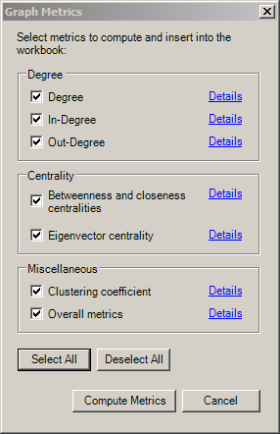
Figure 5.2: NodeXL Graph Metrics dialog with all metrics selected

Slide 26
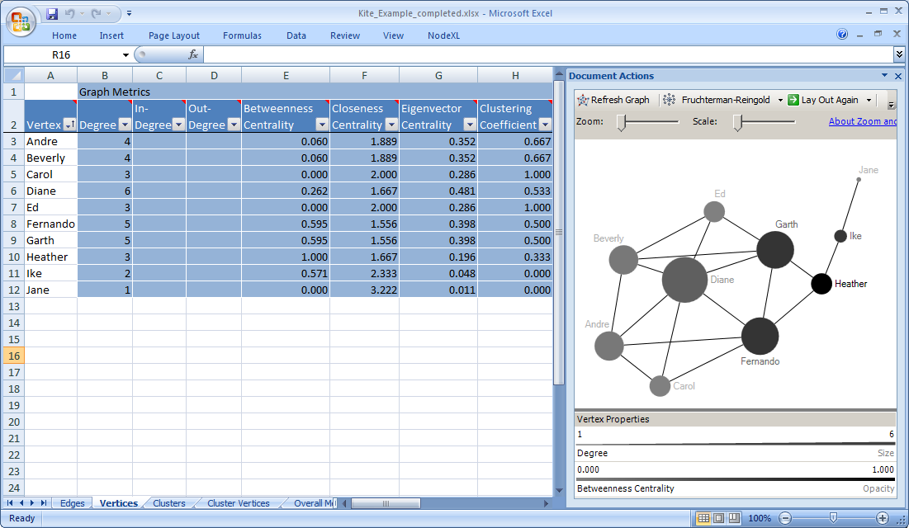
Figure 5.3: The Kite Network showing graph metrics for each vertex. Degree is mapped to Size (1.5 - 6), Betweenness Centrality (50 - 100) is mapped to Opacity and Closeness Centrality is set as the Tooltip.

Slide 27
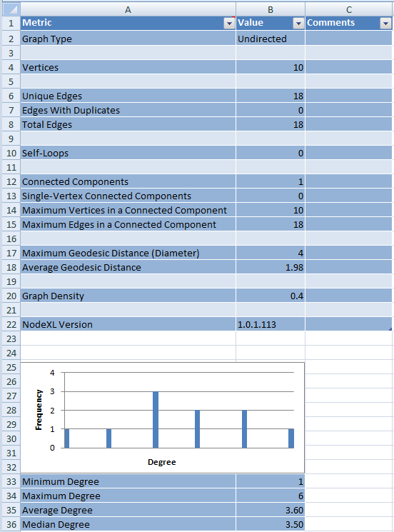
Figure 5.3: NodeXL Overall Metrics worksheet showing aggregate graph metrics for the Kite Network and the frequency distribution of the Vertex-specific metric Degree.

Slide 28
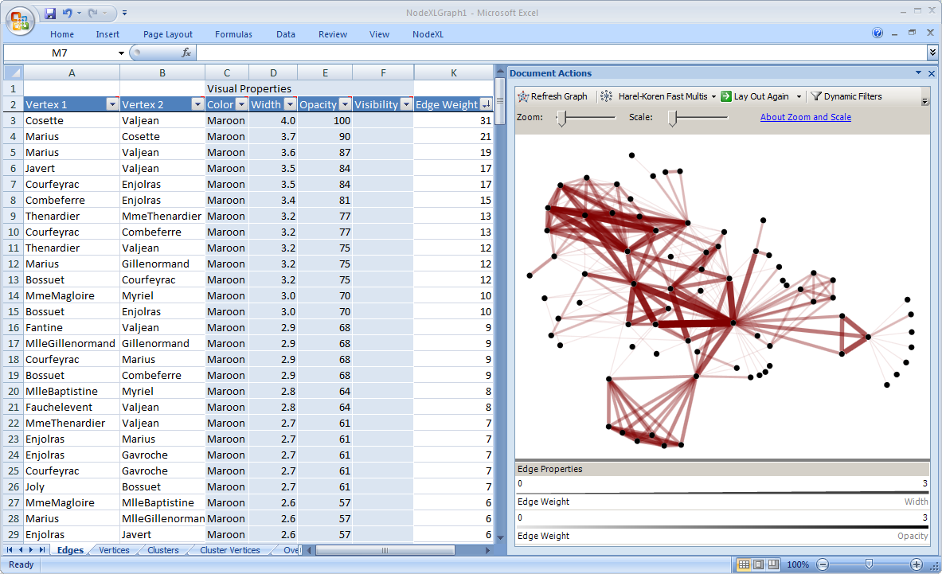
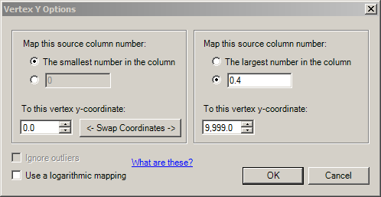
Figure 5.5: Les Misérables character co-appearance network data sorted by Edge Weight from Largest to Smallest and visualized with the Harel-Koren Fast Multiscale layout and some hand-tuning. Edge Width (1-4) and Opacity (10-100) both use data in the Edge Weight column using the logarithmic mapping option. Edges are a different color (Maroon) to keep the vertices identifiable.

Slide 29
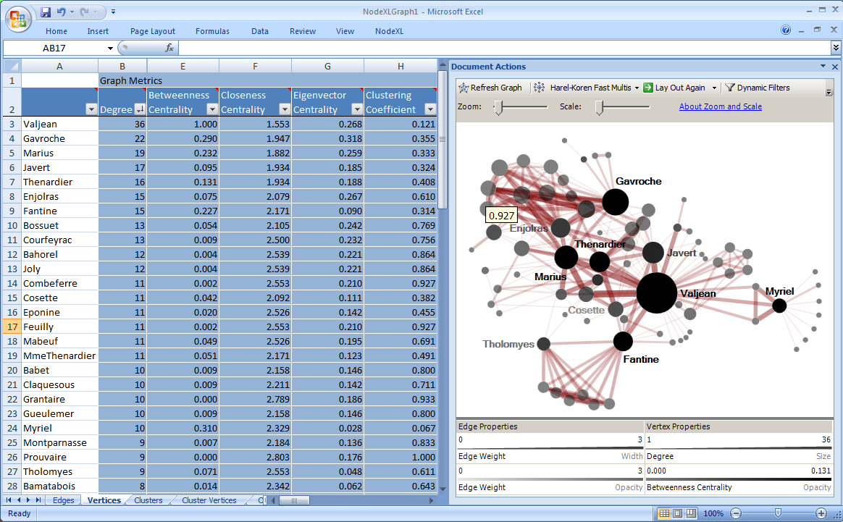
Figure 5.6: Les Misérables Network mapping Degree to Vertex Size (1.5 to 5), Betweenness Centrality to Vertex Opacity (50 to 100), and Clustering Coefficient to Tooltip. Characters with significant metrics are labeled. Edge Width (1 to 4) and Edge Opacity (10 – 60) are based on a logarithmic mapping of Edge Weight.

Slide 30
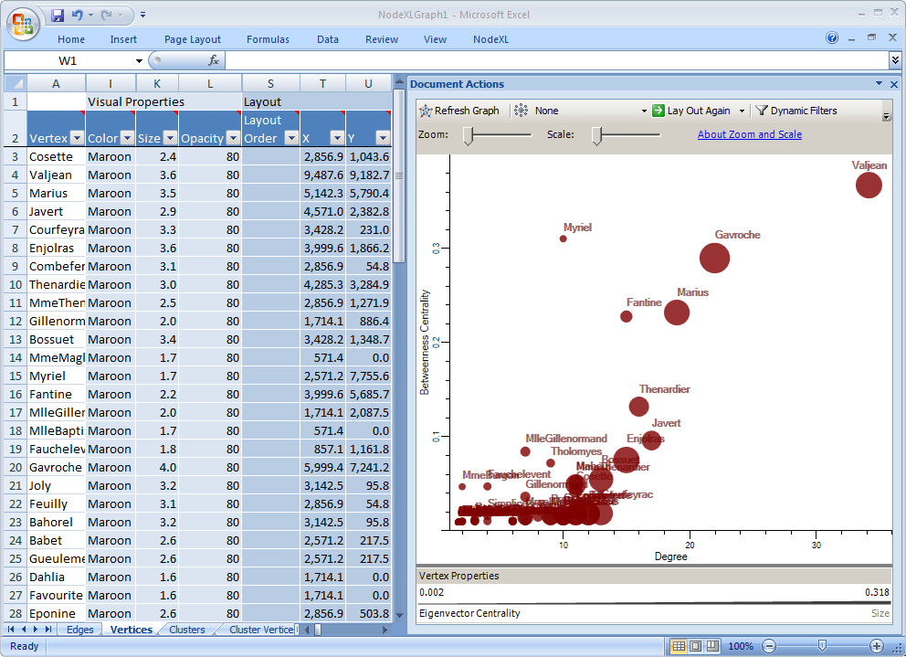
Figure 5.7: Les Misérables Network mapping Degree to the X axis (and Size) and Betweenness Centrality to the Y axis (and Opacity). Axes are shown. Edges are hidden. The scale is modified to account for Valjean’s position as an outlier.

Slide 31
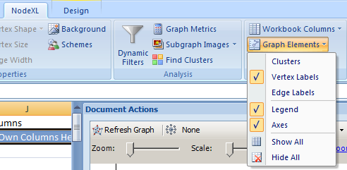
Figure 5.8: Vertex Y Options set to a maximum of 0.4 to remove the outlier Valjean
and scale the Y axis appropriately.
Figure 5.9: Selecting the Graph Elements to Display from the NodeXL Ribbon including Axes

Slide 32
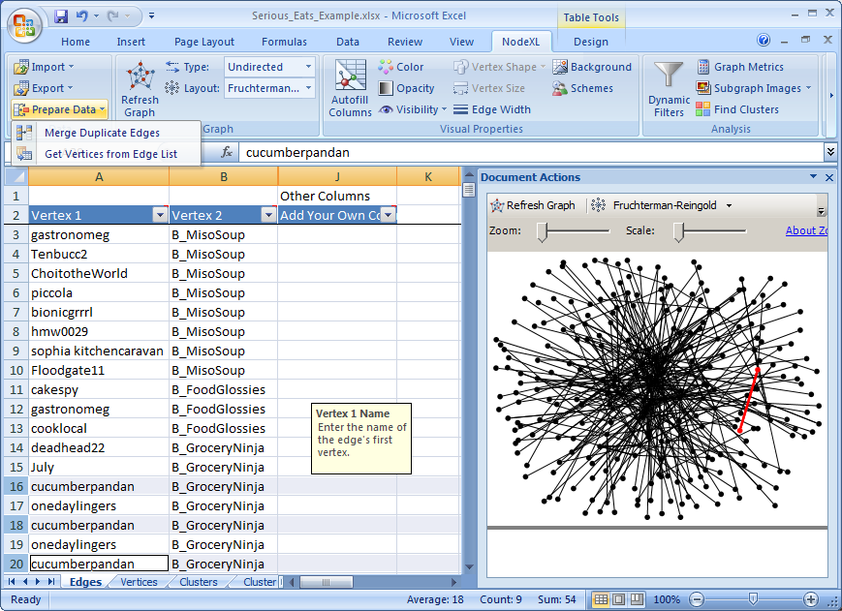
Figure 6.1: SeriousEats unmerged data with duplicate edges. For example, user cucumberpandan is connected to Blog post B_GroceryNinja three separate times (rows 16, 18, and 20), but only 1 edge (in red) connects them. The Prepare Data dropdown on the NodeXL Ribbon is selected in preparation to “Merge Duplicate Edges”

Slide 33
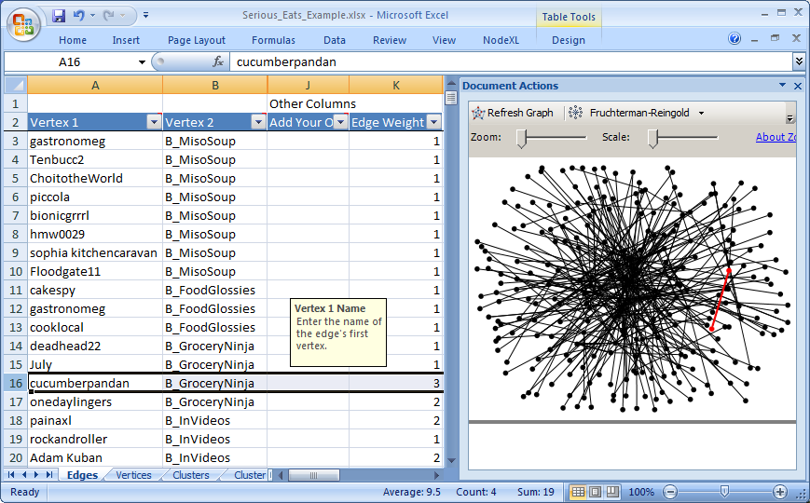
Figure 6.2: Serious Eats merged data showing only one row connecting
user cucumberpandan with Blog post GroceryNinja and a new Edge Weight column

Slide 34
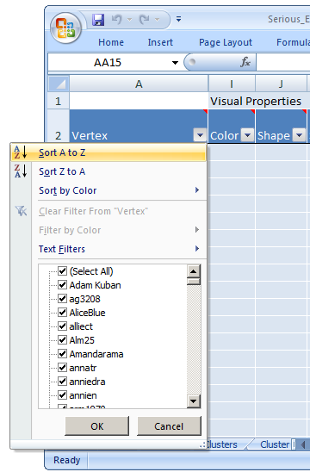
Figure 6.3: Sorting the Vertex column in alphabetical order (Sort A to Z)

Slide 35
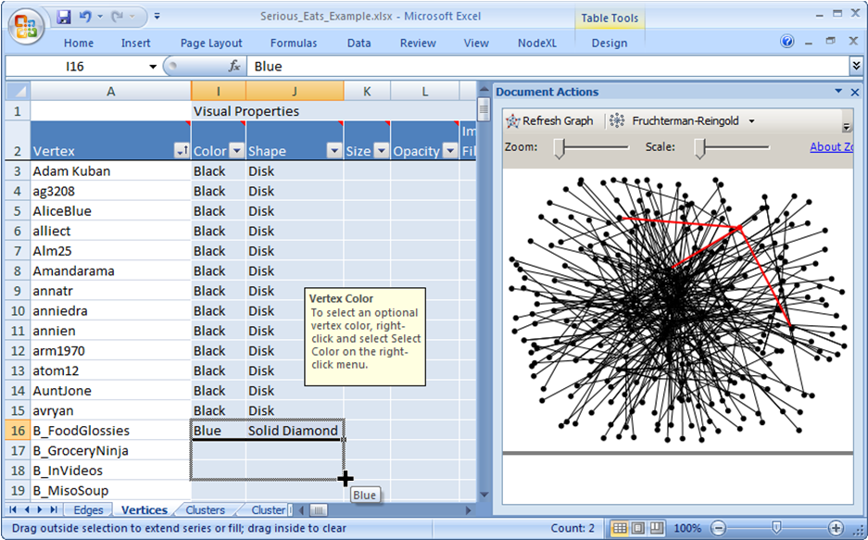
Figure 6.4: Populating the Color and Shape column data for blogs (beginning with “B_”)
by using Excel’s built-in automatic fill tool

Slide 36
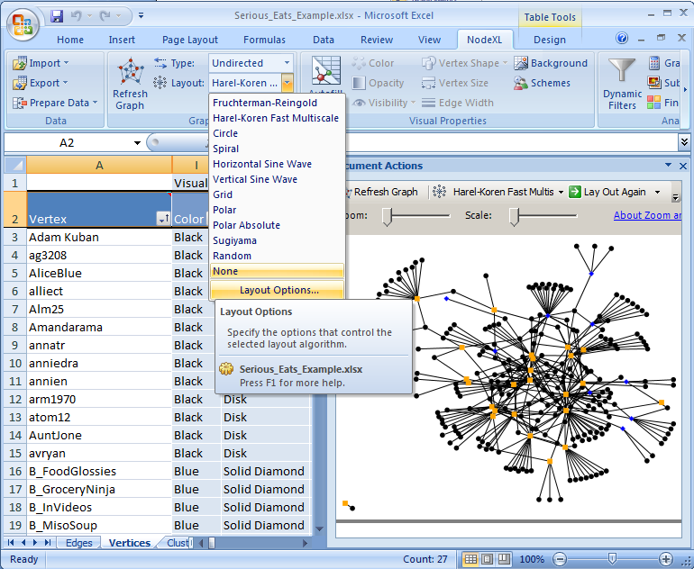
Figure 6.5: Serious Eats updated graph showing users as black disks, Forum topics as orange solid squares, and Blog topics as blue solid triangles. The Harel-Koren Fast Multiscale layout is used. The Layout Options are selected so that the graph’s smaller components can be separated from the larger one (notice the single Forum-username pair in the bottom-left corner of the graph)

Slide 37
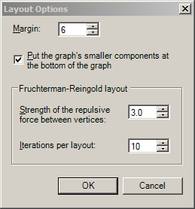
Figure 6.6: Layout Options dialog with the “Put the graph’s smaller components at the bottom of the graph” selected

Slide 38
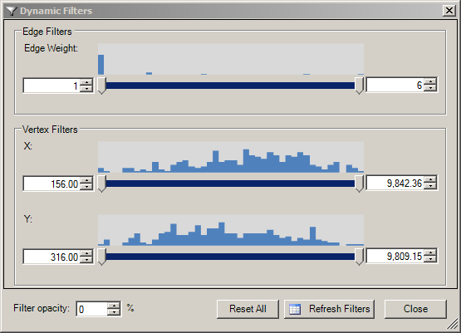
Figure 6.7: NodeXL Dynamic Filters dialog box with double boxed sliders which allow you to set minimum and maximum values to filter out edges or vertices. Frequency distributions are shown visually above each slider.

Slide 39
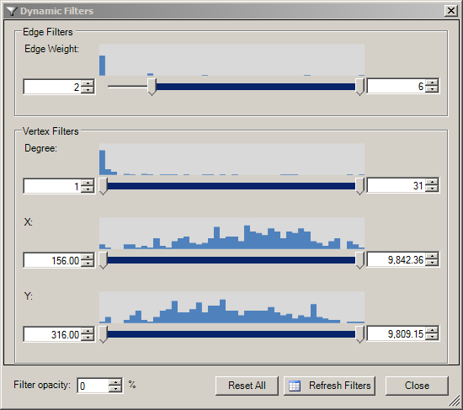
Figure 6.8: NodeXL Dynamic Filters dialogue box after calculating the metric Degree, Choosing Refresh Filters, and increasing the Edge Weight from 1 to 2

Slide 40
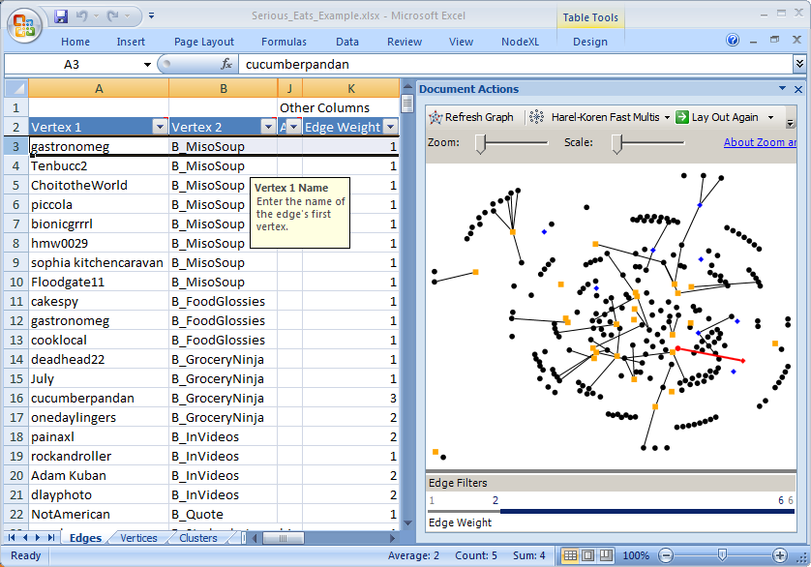
Figure 6.9: A dynamically filtered graph showing only edges with Edge Weight of 2 or higher, except for selected edges such as the one in red connecting user gastronomeg to blog post B_MisoSoup

Slide 41
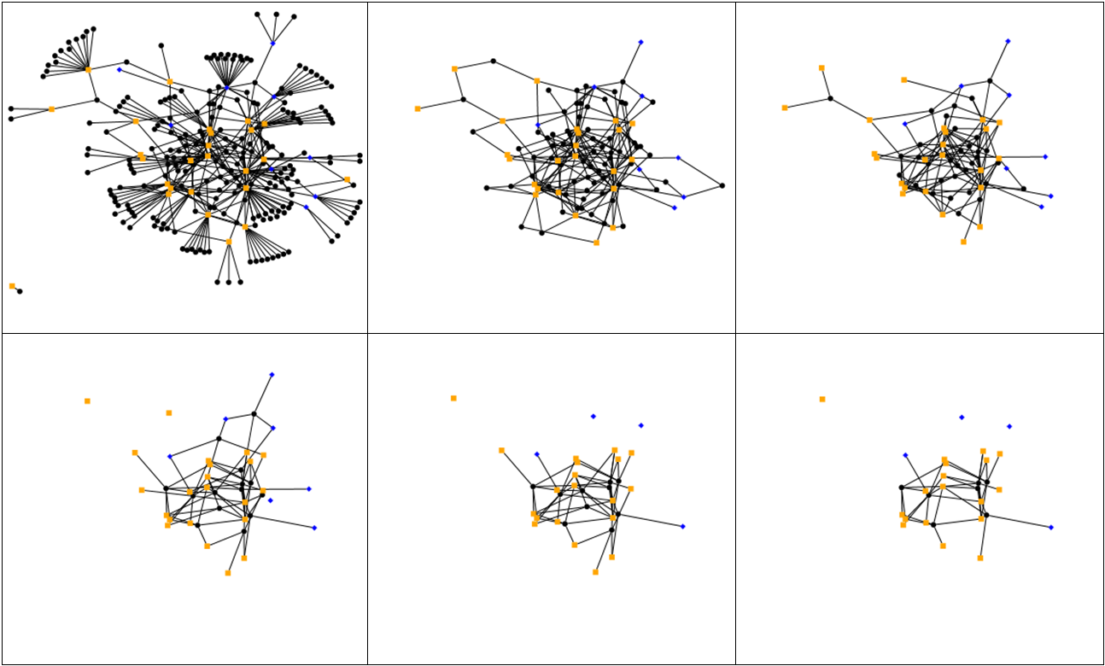
Figure 6.10: Six images of the Serious Eats social media network of blogs, discussions and people created in NodeXL by incrementally increasing the minimum Degree slider beginning with a minimum Degree of 1 (upper-left image) and ending with a minimum Degree of 6 (lower-right image)

Slide 42
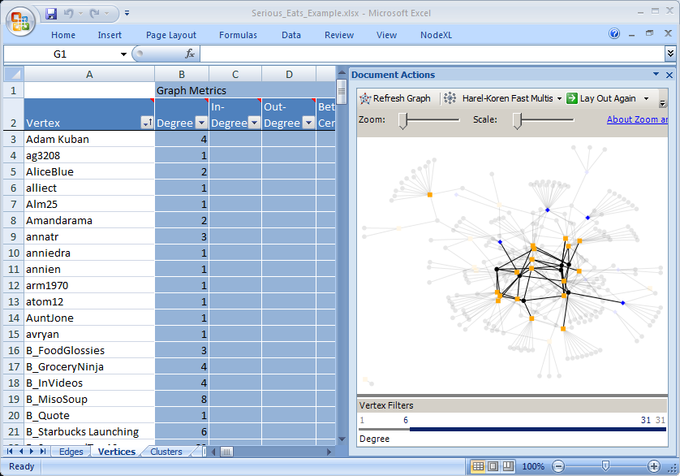
Figure 6.11: Dynamic Filters set to a minimum of 6 Degree with Filter Opacity at 10%

Slide 43
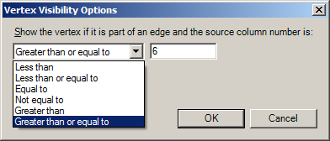
Figure 6.12: Vertex Visibility Options dialog box set to show only Vertices that are Greater than or equal to 6

Slide 44
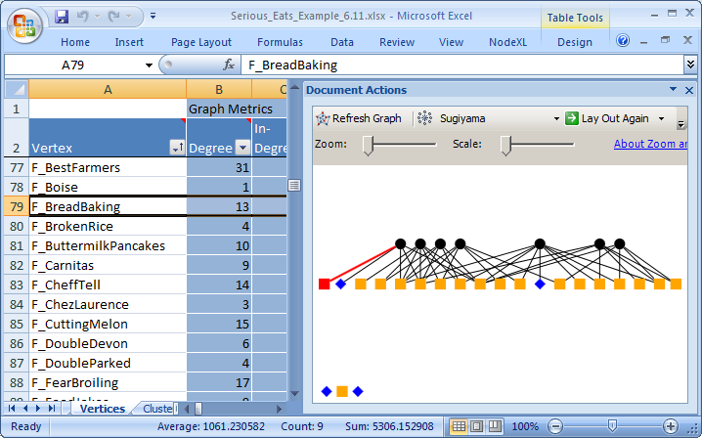
Figure 6.13: NodeXL Autofill Columns filtered view of the Serious Eats social media network, limited by degree of 6 or more. Sugiyama layout is used.

Slide 45
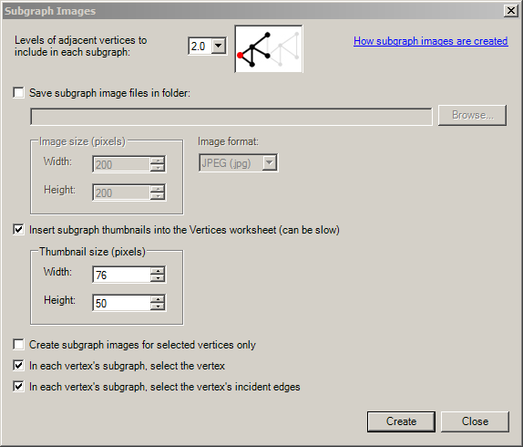
Figure 6.14: Subgraph Images dialog box with the number of adjacent vertices to include set to 2.0

Slide 46
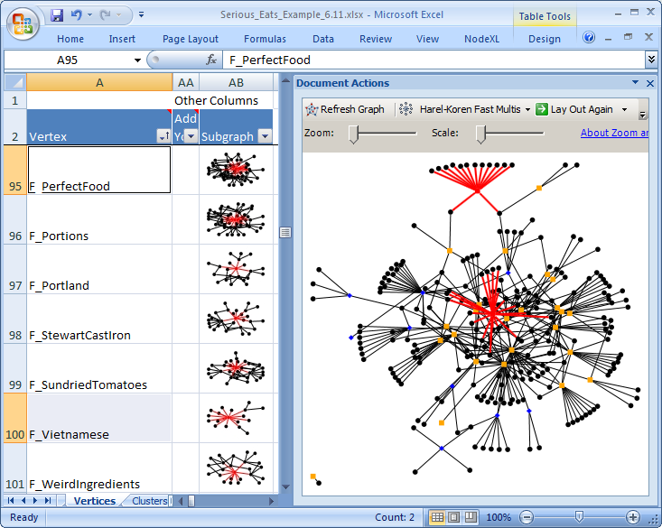
Figure 6.15: Subgraph Images on the Vertices worksheet showing differences between forums
such as Vietnamese (top of graph) and PerfectFood (middle of graph), both of which are selected

Slide 47
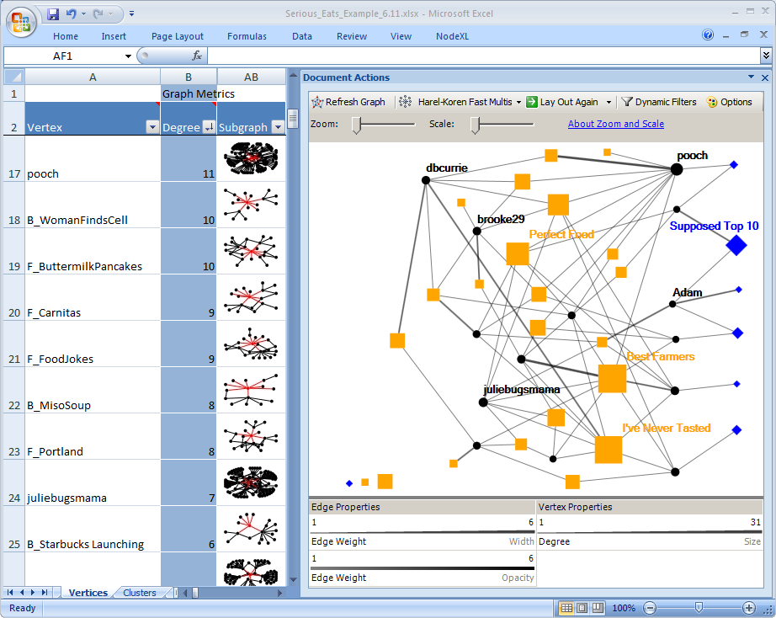
Figure 6.16: Serious Eats visualization emphasizing most important people (black circles), forums (orange squares) , and blogs (blue diamonds).

Slide 49


Slide 50


Slide 51


Slide 52


Slide 53


Slide 54



Slide 55


Slide 56


Slide 57








Each contains one or more social networks
World Wide Web

Slide 59


Slide 60


Slide 61


Slide 62


Slide 63


Slide 64


Slide 65


Slide 66


Slide 67


Slide 68


Slide 69


Slide 70
TOPIC 1: Social Media
Thread A | Adam | 12/10/2010 2:30pm
Re: Thread A | Beth | 12/10/2010 5:30pm
Thread B | Cathy | 12/13/2010 11:00am
Re: Thread B | Dave | 12/14/2010 3:30am
Re: Re: Thread B | Beth | 12/14/2010 12:00pm
Re: Thread B | Ethan | 12/15/2010 10:00am
Re: Re: Thread B | Dave | 12/15/2010 1:30pm
Re: Re: Re: Thread B | Cathy | 12/16/2010 1:00pm
TOPIC 2: NodeXL
Thread C | Dave | 12/10/2010 9:30am
Re: Thread C | Beth | 12/11/2010 10:00am
Thread E | Fiona | 12/14/2010 9:00am
Re: Thread E | Fiona | 12/14/2010 9:05am
Thread D | Greg | 12/13/2010 8:00am

Slide 71


Slide 72


Slide 73


Slide 74


Slide 75


Slide 76


Slide 77


Slide 78


Slide 80



Scott Golder (@redlog) is a graduate student in Sociology at Cornell University. He was previously a researcher at HP Labs, and holds an A.B. in Linguistics with Computer Science from Harvard University and an M.S. in Media Arts and Sciences from the MIT Media Laboratory. His research interests broadly include network and social identity effects online, which he has examined in a variety of environments including usenet, online poker, social bookmarking and social network services. His website is www.redlog.net.
Vladimir Barash (@vlad43210) is a graduate student in Information Science at Cornell University. He holds a BA in Cognitive Science from Yale University. His research interests include social media, online communities and diffusion, and his thesis topic is on the structural properties of diffusion in social networks. His websited is www.vlad43210.com

Slide 81


Slide 82


Slide 83


Slide 84


Slide 85


Slide 86


Slide 87


Slide 89


Bernie Hogan is a Research Fellow at the Oxford Internet Institute at the University of Oxford. Bernie's work focuses on the process of networking, or maintaining connections with other people. His dissertation focused on the use of multiple media for networking while his current research on Facebook looks at the complexities of networking with multiple groups on a single site.

Slide 90


Slide 91


Slide 92


Slide 94

Robert Ackland is a Fellow at the Australian National University. He works on the development of new approaches (and associated software) for empirical social science research into online social and organizational networks, and has recently studied the networking behavior of political bloggers and environmental activists. Robert has degrees in economics from the University of Melbourne, Yale University (where he was a Fulbright Scholar) and the ANU, where he completed his PhD in economics in 2001.
In 2005 he established the Virtual Observatory for the Study of Online Networks (http://voson.anu.edu.au) project and in 2007, he was awarded a UK National Centre for e-Social Science Visiting Fellowship and an Oxford University James Martin Visiting Fellowship (at the Oxford Internet Institute). Robert coordinates the ANU's Master of Social Research programme and teaches courses on the social science of the Internet and online research methods. He is currently writing a related book (to be published by SAGE).

Slide 95


Slide 96


Slide 97


Slide 98


Slide 100


Eduarda Mendes Rodrigues is an Assistant Professor of Informatics Engineering at the University of Porto, Portugal. Her research interests lie in the broad areas of data mining and web information retrieval. In particular, her current research is focused on the interplay between social sciences and web technologies, aiming to develop effective data mining techniques for characterizing user behavior in online communities and improving information retrieval in social media. She holds a Ph.D. in Electronic & Electrical Engineering from University College London, UK.
As Principal Researcher at Microsoft Research Cambridge (MSRC), Natasa Milic-Frayling is setting research directions for Integrated Systems group (http://research.microsoft.com/is), a cross-disciplinary team focused on design, prototyping and evaluation of information and communication systems and services. She also serves as Director of Research Partnership with industry (http://research.microsoft.com/rpp), the MSRC programme that facilitates collaboration between MS Research and industry leading partners and clients. Natasa is actively involved with a wider industry and academic community, promoting research and innovation through public speaking and research engagements.

Slide 101


Slide 102


Slide 103








Slide 104


Slide 105


Slide 106


Slide 108


Dana Rotman is a PhD candidate at the University of Maryland iSchool. She holds an L.Lb in Law from the Hebrew University in Jerusalem, and an MA in Information Studies (Cum Laude) from Bar-Ilan University in Israel. Her research lies in the intersection of content and structure of social media. Currently she is studying the effect different tools and communication intentions have on the interaction created around videos that are shared online. She is the recipient of the 2009 Yahoo! Key Scientific Challenges Award.
Jennifer Golbeck is an Assistant Professor in the College of Information Studies at the University of Maryland, College Park where she is co-director of the Human-Computer Interaction Lab. Her research interests are generally artificial intelligence and human computer interaction, specifically addressing social networks, trust, and web science, with a theme of leveraging social information to build intelligent interfaces and improve information access.

Slide 109

Figure 14.10 : NodeXL map of Leesha Harvey’s ego-centric YouTube network with images, edges filtered by edge weight and vertices by degree. This layout shows the most connected users in Leesha Harvey’s network, most of whom are her friends, with only one subscriber included in the network. Clicking on the images will link to the users’ channels and will show that the majority of them share the same musical genre as Leesha Harvey.

Slide 110

Figure 14.13: NodeXL graph of the YouTube Makeup video network after filtering for edge weight ≥ 5, opacity mapped to edge weight, and clusters computed. You can observe five major clusters of videos, two of which (pink and green) are visibly denser hubs of interconnections that span outside the cluster to include videos that belong to other clusters, and the other three (blue red and orange) are more sparse, and less inter-connected. Several isolates are placed at the bottom of the graph.

Slide 111

The position of “Natural makeup” within the NodeXL graph of the YouTube makeup video network. Vertex opacity and size are mapped to views and comments, respectively. The betweenness centrality of this video indicates that it bridges between one otherwise isolated cluster and several other clusters. It is a boundary object that connects several communities of interest in the network; however, this role is not reflected in overall popularity of the video in the YouTube network.

Slide 112


NodeXL maps of the “Queen of hearts” (I), the highest-rated video in the YouTube makeup video network is an isolate, while “Beau Nelson’s Essential Makeup Tips” (II), the most favorited video in the network, is peripheral to the core of the network, connected to only one other video.

Slide 113

NodeXL chart with vertex size mapped to Degree, Opacity to number of views, and vertex visibility to the number of comments a video received, Panacea81’s “Leona Lewis ‘Bleeding Love’ inspired makeup look” video stands out as combining the highest centrality metrics as well as the highest overall popularity measures in the YouTube network. This video, and its author, can be a good starting point for exploring the network and for commercial efforts.

Slide 114

NodeXL map of YouTube Healthcare reform videos with color and size corresponding to views and comments respectively. The number of comments and views do not necessarily correlate: red vertices, which generated many comments, are not always the most viewed (mapped to larger size), while several blue vertices (low number of comments) were viewed as many times as the more commented-on videos.

Slide 115

NodeXL map of YouTube Healthcare reform video network with color and size responding to the number of comments and ratings for each video, respectively. The blue vertices, which are not frequently commented-on, received (in general) higher ratings than the more commented-on videos. This may be the outcome of contentious content that generated heated discussion but dissent that was reflected in lower ratings. The highlighted video has the highest betweenness centrality, making it a pivotal video in the online discussion.

Slide 116

NodeXL map of clusters of YouTube videos discussing healthcare reform linked by shared comments. With two exceptions (the yellow cluster reflecting opponents to the Administration health care plan, and the red cluster reflecting videos supporting the plan), most clusters do not portray contextual ties between the videos.

Slide 118





Howard T. Welser is an Assistant Professor of Sociology at Ohio University, where he explores issues of social change and technology in courses on group processes, introduction to sociology, and research methods. His research investigates how micro-level processes generate collective outcomes, with application to status achievement in avocations, development of institutions and social roles, the emergence of cooperation, and network structure in computer mediated interaction. He has a Ph.D. in sociology from the University of Washington.
Patrick Underwood a PhD student in sociology at the University of Washington. His master's thesis investigates how online communities maintain cohesion and group boundaries and how online social interaction makes the transition to offline group action. He is primarily interested in how individuals form and maintain social interactions in online spaces. He is also interested in the growing impact of internet communications technologies upon "offline" life and the growing prominence of video games within popular culture.
Dan Cosley is an assistant professor of information science at Cornell University. His primary interest is helping groups make sense, use, and reuse of information, from motivating people to contribute more to communities like Wikipedia by mining their prior behavior in the group to supporting reminiscence by re-using content created in social media systems. He is also interested in the general problem of how to use theory, principles, and models to build and evaluate real systems. He has a Ph.D. in computer science from the University of Minnesota.
Derek L. Hansen is an Assistant Professor at Maryland’s iSchool and Director for the Center for the Advanced Study of Communities and Information (http://casci.umd.edu). He is also an active member of the Human Computer Interaction Lab (http://www.cs.umd.edu/hcil/). His research focuses on mass collaboration, consumer health informatics, alternate reality games (ARGs), and social network analysis and visualization of online interactions. Dr. Hansen has a PhD from the University of Michigan’s School of Information.
Laura W. Black is an Assistant Professor in the School of Communication Studies at Ohio University. She studies public deliberation, dialogue, and conflict in small groups and is specifically interested in how people tell and respond to personal stories during small group discussions. Her research on social media includes studies of decision making in Wikipedia, conflict management in an online public forum, and social support in the online weight loss community FatSecret. She has a Ph.D. in communication from the University of Washington.

Slide 119

This NodeXL network graph depicts user to user talk page connections from a Wikipedia policy article. The graph illustrates one way that styles of contribution are tied to structural attributes. Note that the red nodes (most confrontational) are involved in the strongest dyadic ties, and they tend to have the highest

Slide 120

NodeXL visualization of Lostpedia wiki user-to-user affiliation network connecting users (vertices) based on the number of unique pages they have both edited (weighted edges). Two types of edges are included: Those connecting users based on co-edits of 20 or more Theory pages (Green) and those connecting users based on co-edits of 150 or more Articles (Maroon). Vertex size is based on total wiki edits and color is based on the percentage of pages that are Theory pages (green vertices edit mostly Theory pages and Maroon mostly Article pages). Boundary spanners and important individuals are easily identified.

Slide 121

NodeXL Edges worksheet and visualization of a Lostpedia wiki user-to-user affiliation network graph with edges filtered based on the number of pages that users share as a percentage of the total number of edited pages. The number of edges for frequent editors like Santa (highlighted in red) are significantly reduced, but size indicates importance.

Slide 122


Slide 123
Forthcoming, Summer 2010

